Slide 1
DTSA 5509 Supervised Learning Project
Predicting Redo Ablation Risk: A Supervised Learning-Based Clinical Scoring System

Slide 2
Objectives
Predict Redo Ablation Using Supervised Machine Learning Build and evaluate predictive models (e.g., logistic regression, random forests, neural networks) to identify patients at risk for redo ablation
Develop a Clinically Interpretable Risk Score Derive and validate a point-based clinical risk score from model features to aid clinicians in assessing the likelihood of redo ablation, facilitating real-time decision-making and patient stratification

Slide 3
Data Description
https://physionet.org/content/shdb-af/1.0.1/
Years 2019 and 2023
128 ECG records (24 hours)
ECGs are stored in WFDB format
Patient data was anonymized per HIPAA, with random 3-digit ID
Various demographic data obtained

Slide 4
Pre-Processing
ECG Extraction
Loaded the ECG and attached it to the dataset per patient ID
Detect R to R peaks
Obtain heart rate variability
Obtain entropy values
Then append to the final dataset
Evaluate for missing data
Dropped columns with 100% missing
Some columns were missing because 1 = yes, and 0 = no, impute 0
For less % missing, impute mean for continuous variables
For columns with multiple categorical values
Used one-hot encoding

Slide 5
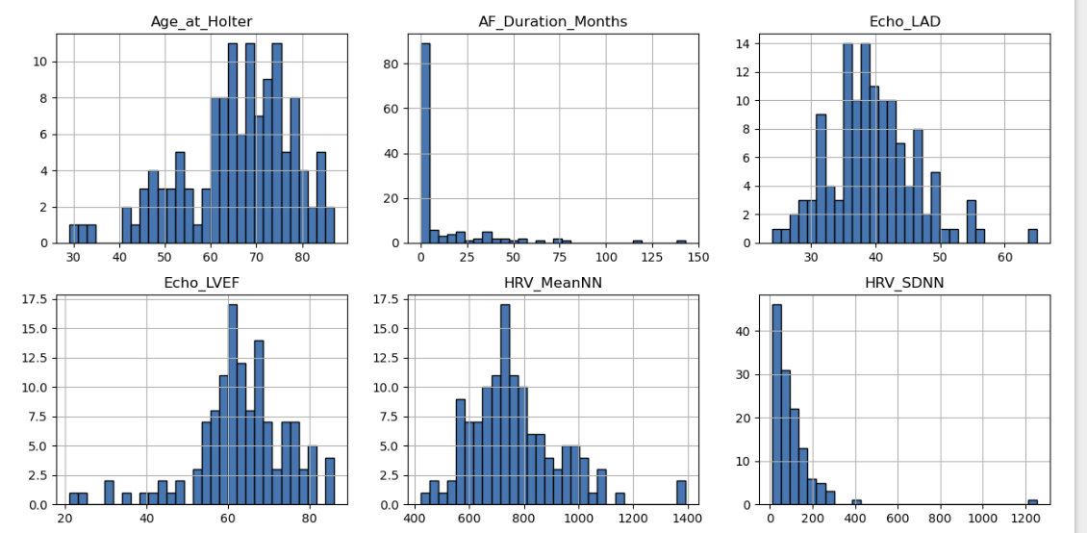
Exploratory Data Analysis
Age
AF duration
LAD
LVEF
HRV

Slide 6
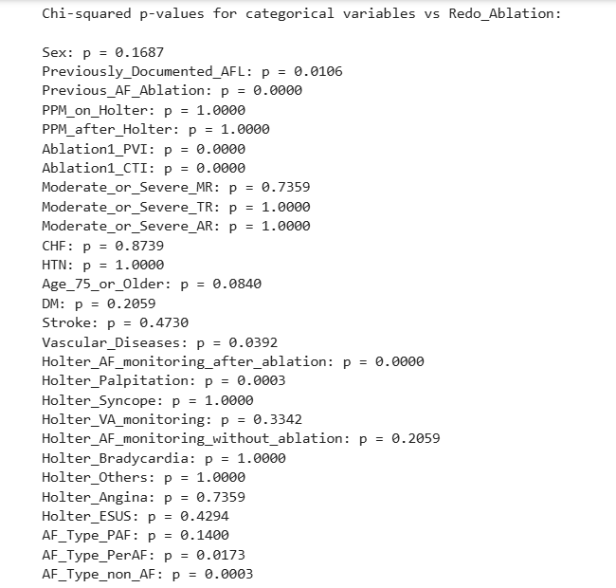
Exploratory Data Analysis
Significant with Redo
PVI: p < 0.001
CTI: p < 0.001
Vasc dx: p 0.0392
Holter after ablation for AF: p < 0.001
Holter for palpitation: < 0.001
AF non AF type: < 0.001

Slide 7
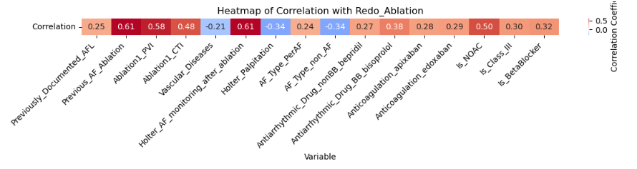
EDA: Biserial Correlation
Previous ablation
PVI
CTI
AF monitoring
NOAC

Slide 8
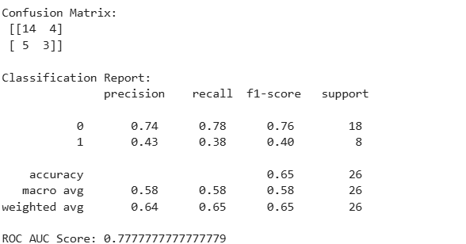
Machine Learning: LR

Slide 9
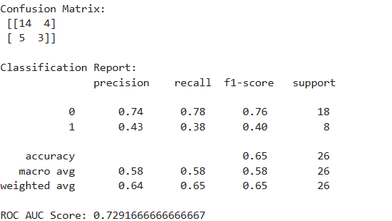
Machine Learning: LR with SMOTE
A little worse AUC
Similar PR F1 scores

Slide 10
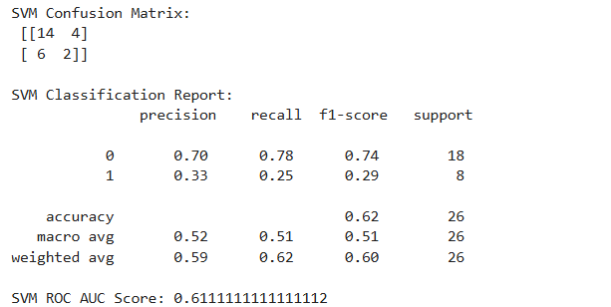
Machine Learning: SVM
Worse AUC and F1 scores than LR or LR with SMOTE

Slide 11
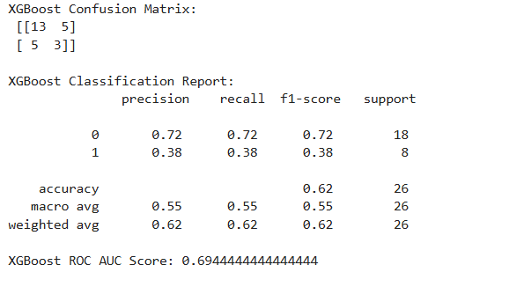
Machine Learning: XGBoost

Slide 12
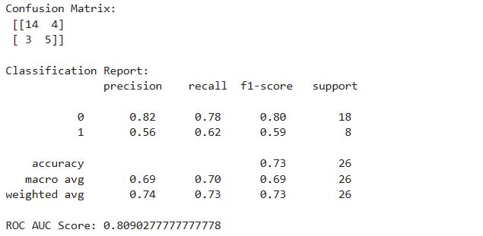
Machine Learning: RF with SMOTE

Slide 13
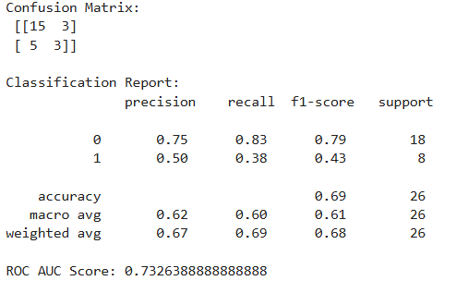
Machine Learning: RF Select Forward

Slide 14
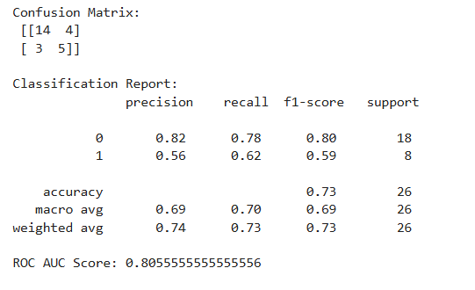
Machine Learning: RF Tuning Depth Split

Slide 15
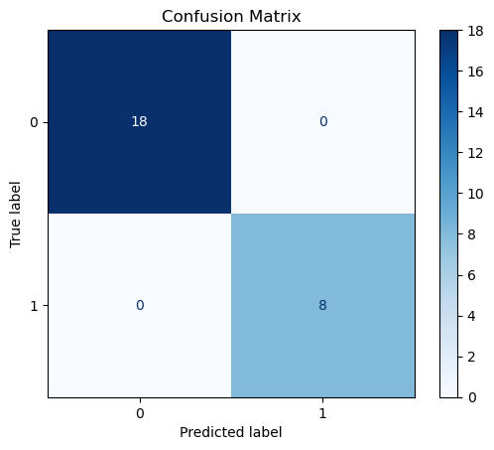
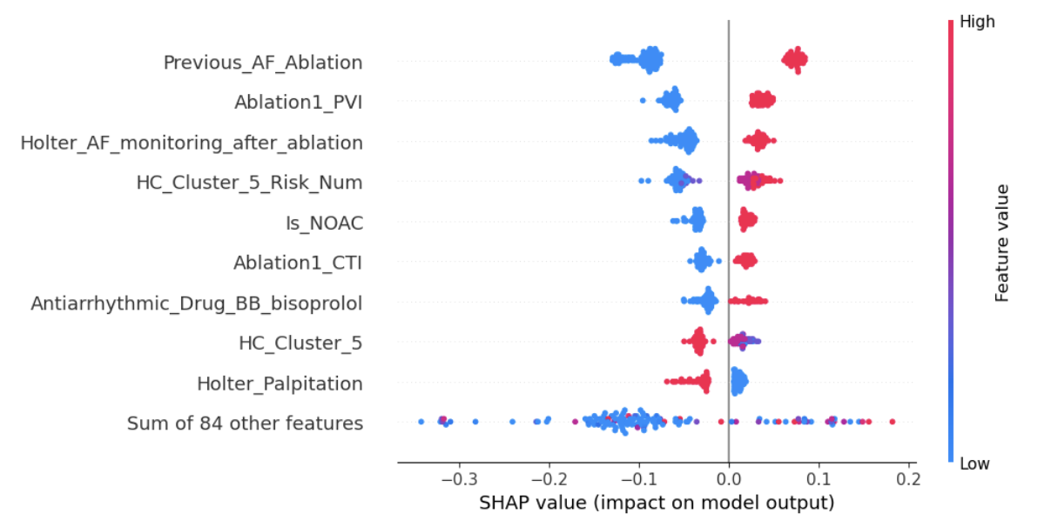
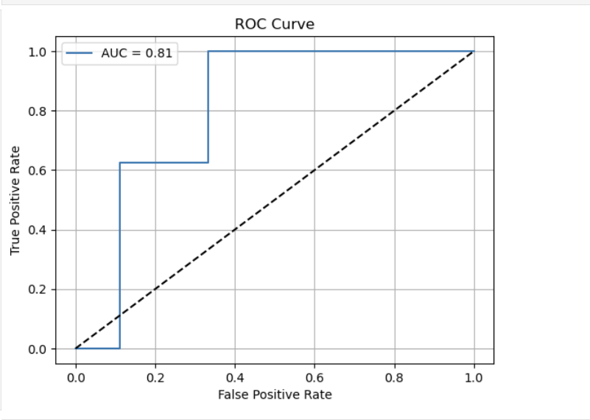
RF Tuned Validation

Slide 16
RF Tuned Cross Validation
Fold | Accuracy | Precision (Class 1) | Recall (Class 1) | F1-Score (Class 1) | ROC AUC
Fold 1 | 0.92 | 1.00 | 0.71 | 0.83 | 0.977
Fold 2 | 0.77 | 0.57 | 0.57 | 0.57 | 0.842
Fold 3 | 0.96 | 0.86 | 1.00 | 0.92 | 1.000
Fold 4 | 0.92 | 0.75 | 1.00 | 0.86 | 0.965
Fold 5 | 0.80 | 0.55 | 1.00 | 0.71 | 0.842
Mean | 0.87 | 0.74 | 0.86 | — | 0.93

Slide 17
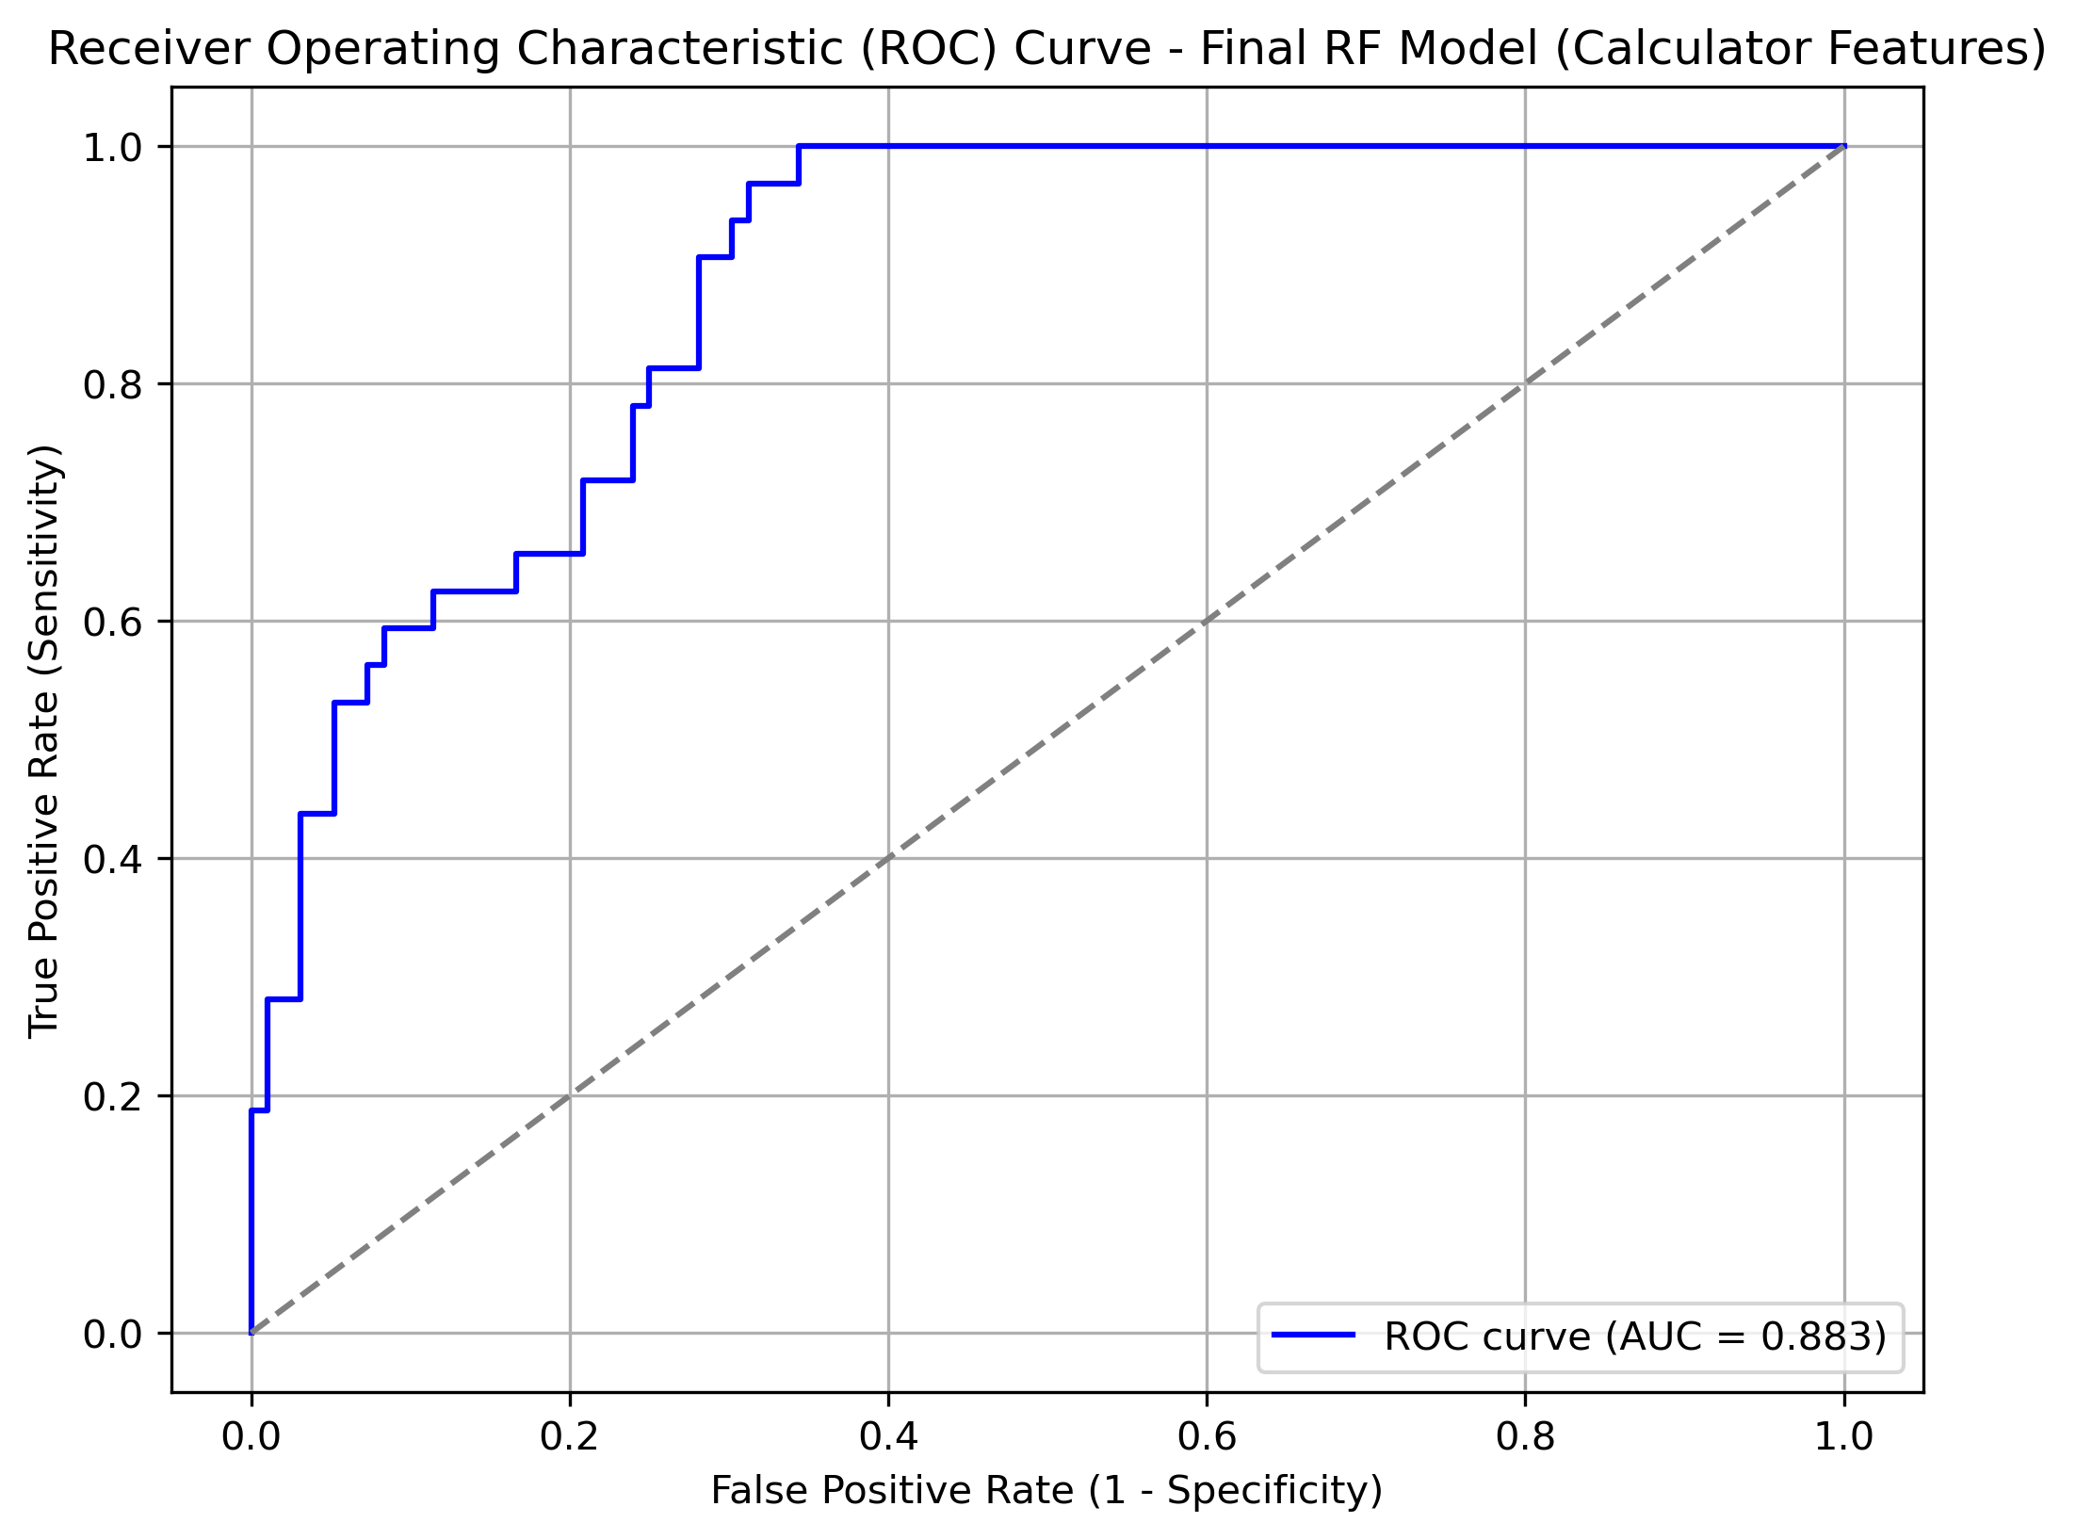
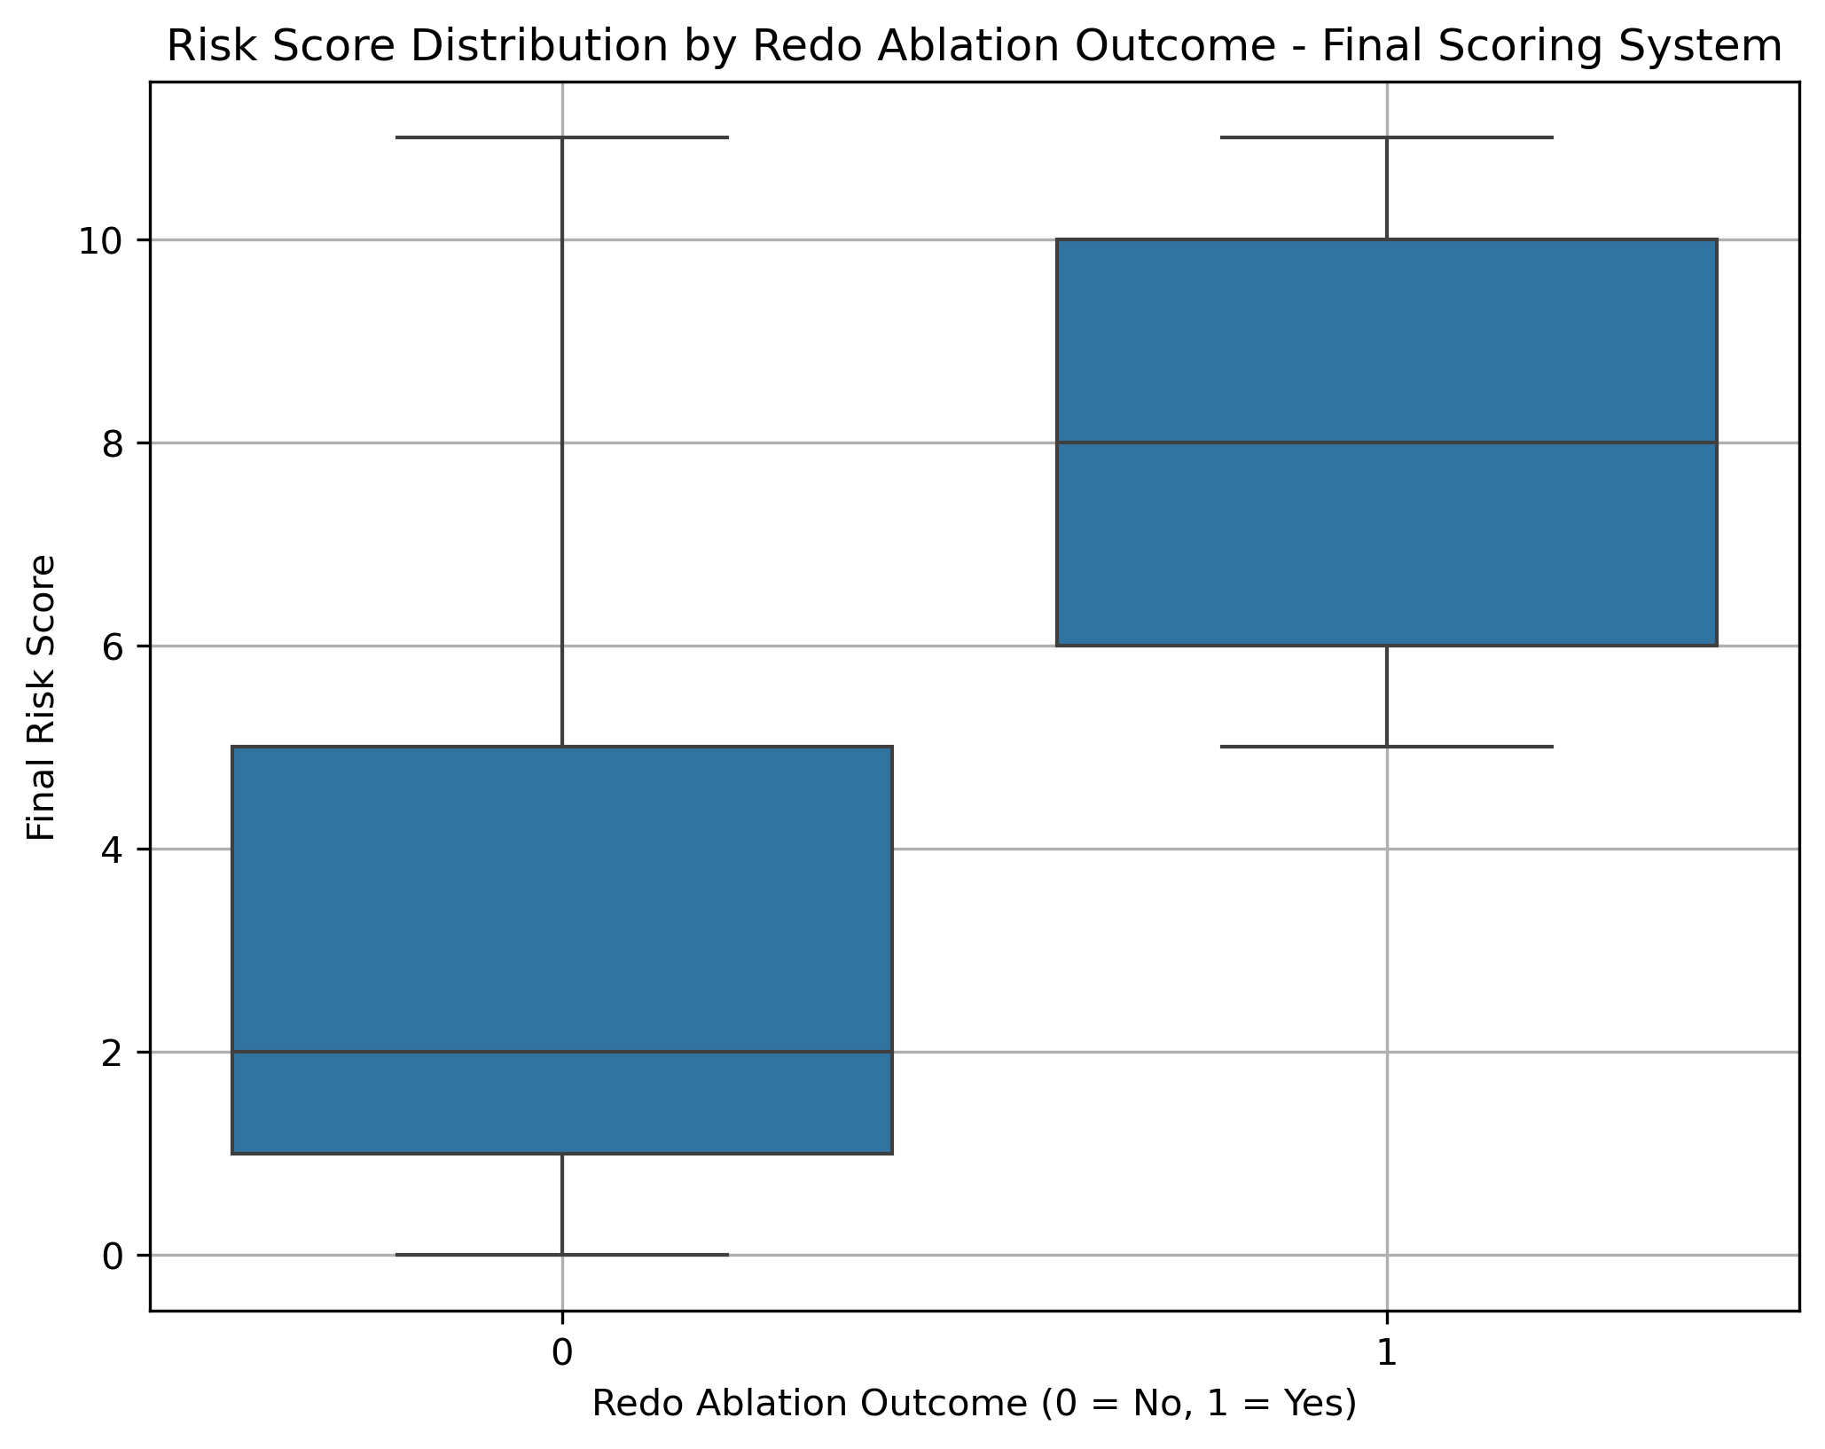
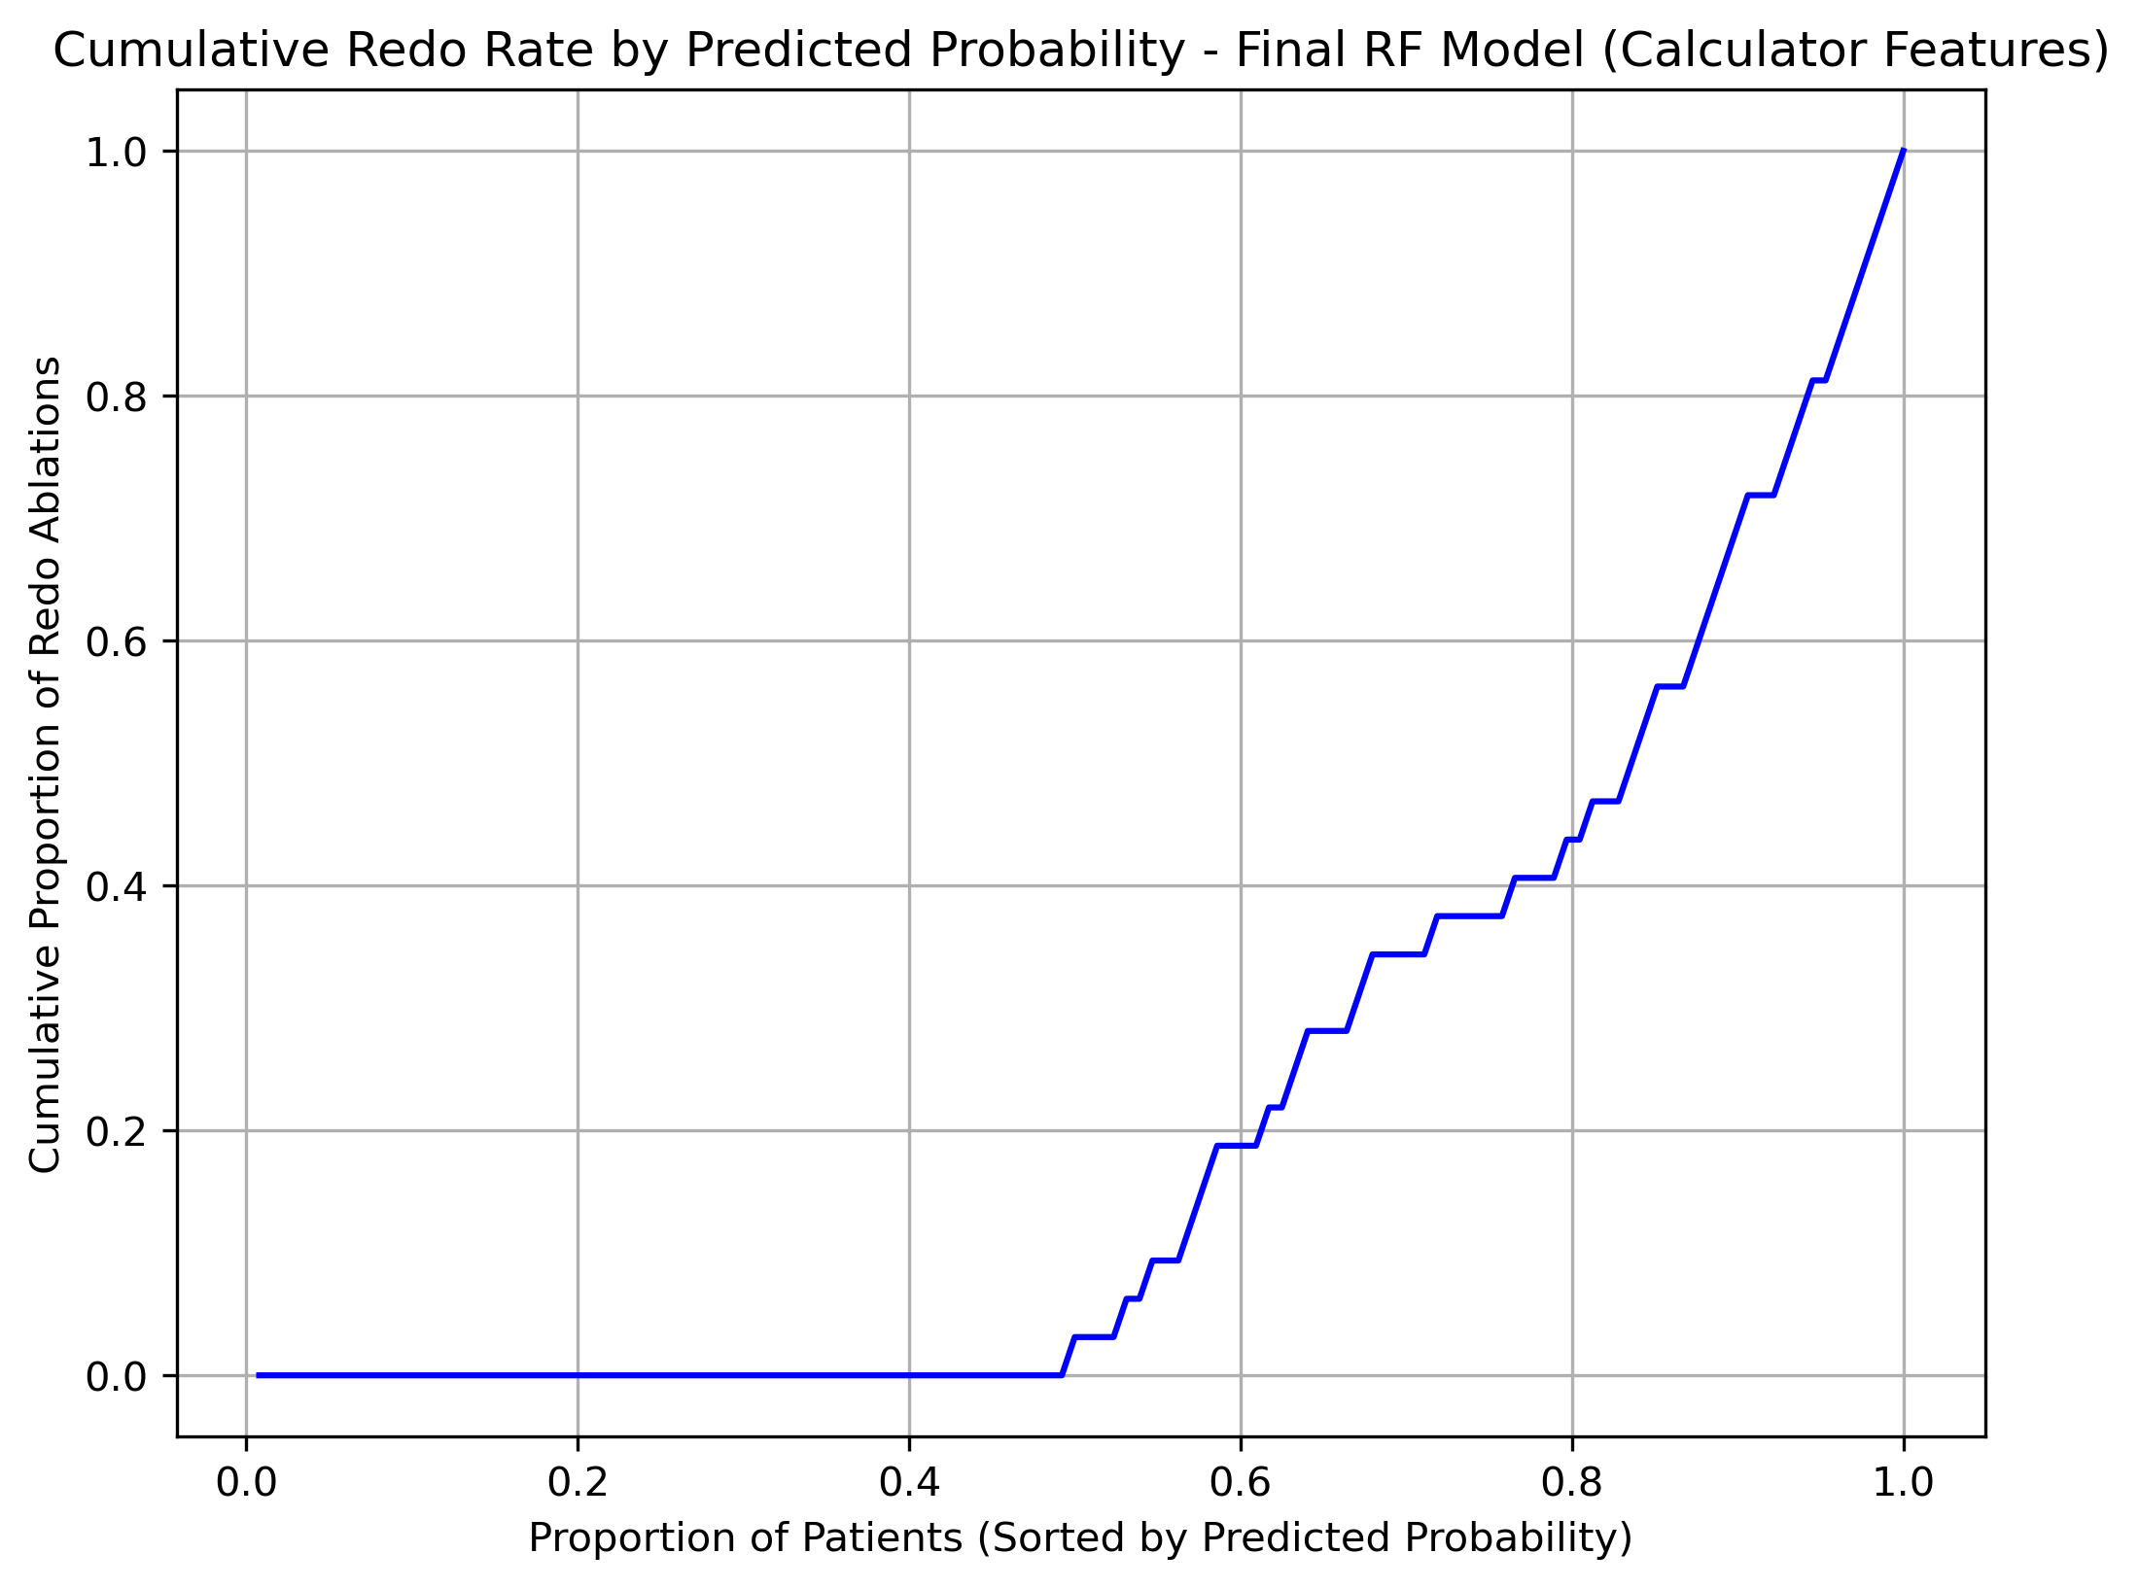
Clinical Scoring System

Slide 18
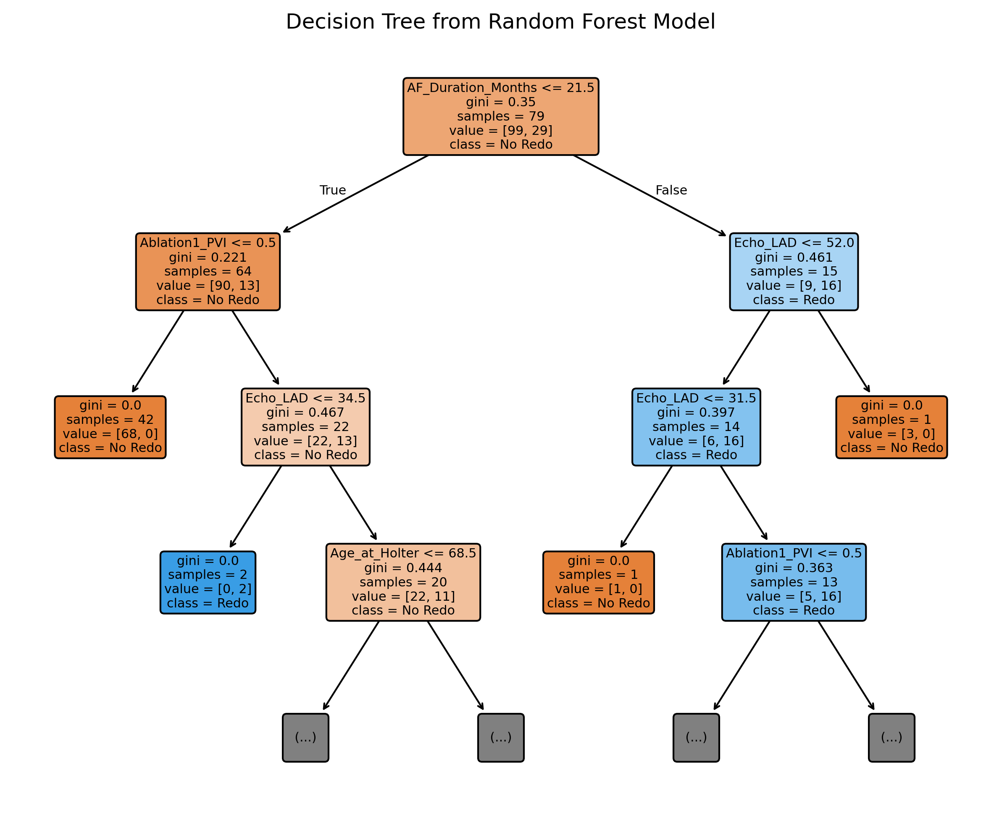

Slide 19
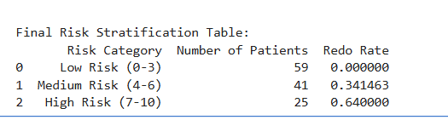
Clinical Scoring System

Slide 20
Summary
Predict Redo Ablation
PVI, CTI, Vasc dx, Holter after ablation for AF, Holter for palpitation, AF non AF type
Develop a Scoring System to Predict Redo Ablations by Risk
Risk of Redo
Low 0% risk of redo
Moderate 35% risk of redo
High 64% risk of redo
Scoring system
Base +2
PVI +5
AF duration >= 1 yr +4
LAD >= 35 mm - 1
Age >= 70 years - 1

Slide 21
Github
https://github.com/Vorlon41/Master-of-Data-Science-CU-Boulder-Colorado/tree/main/Machine%20Learning/DTSA%205509%20Introduction%20to%20Machine%20Learning%20Supervised%20Learning/Final

